Slide 1
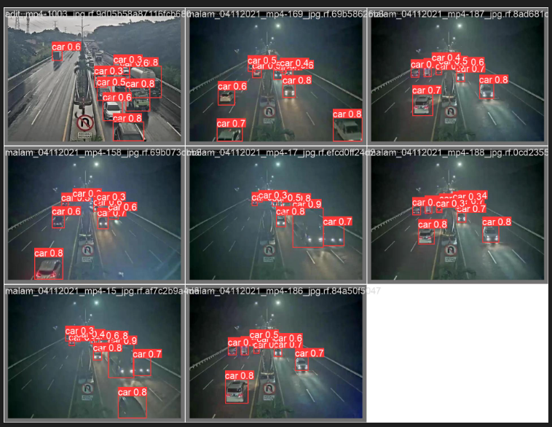
车辆检测 map50: 0.87318
Notes:
10242 /mnt/sde/niuyuanzhuo/yolov8-video-people-counter-main

Slide 2
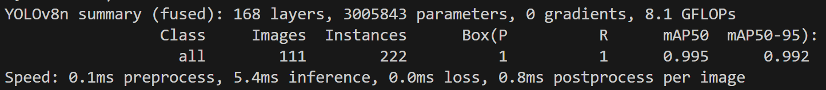
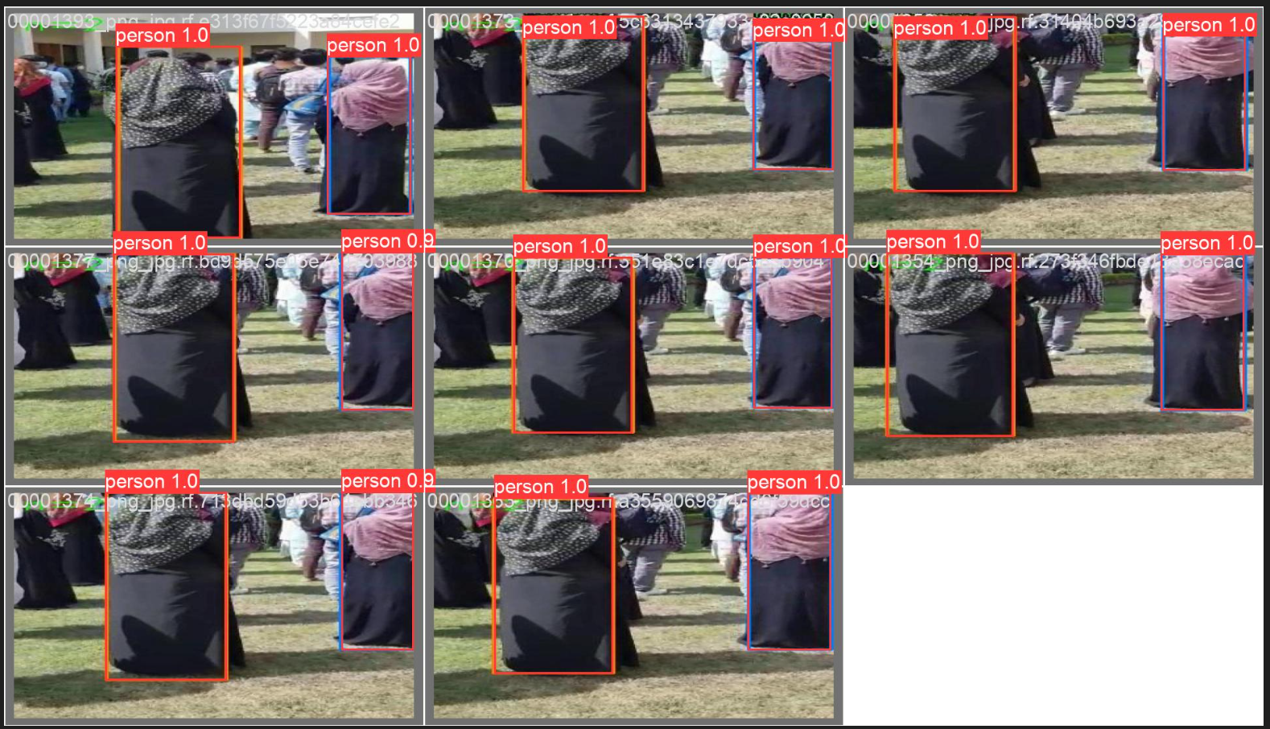
行人检测 map50: 0.87318
Notes:
10242 /mnt/sde/niuyuanzhuo/yolov8-video-people-counter-main

Slide 3
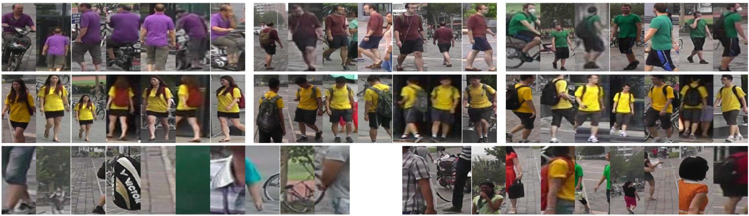
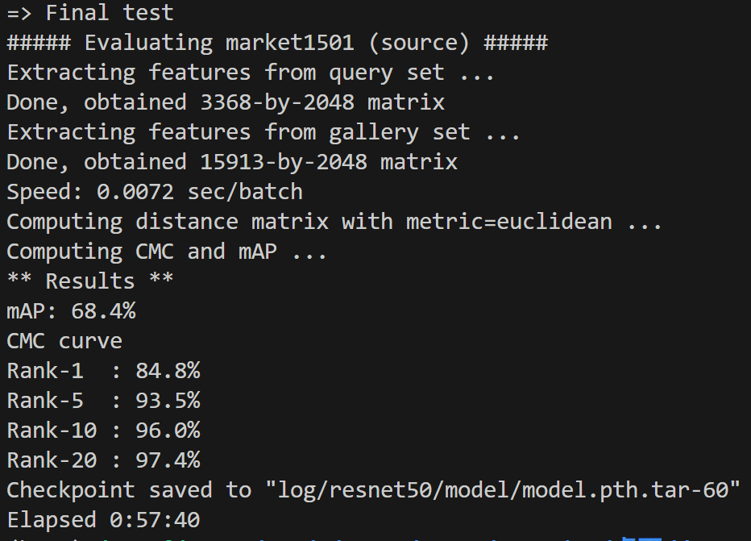
RE-ID
数据集
market1505
Notes:
自己电脑/mnt/c/Users/17735/OneDrive/桌面/deep-person-reid-master

Slide 4
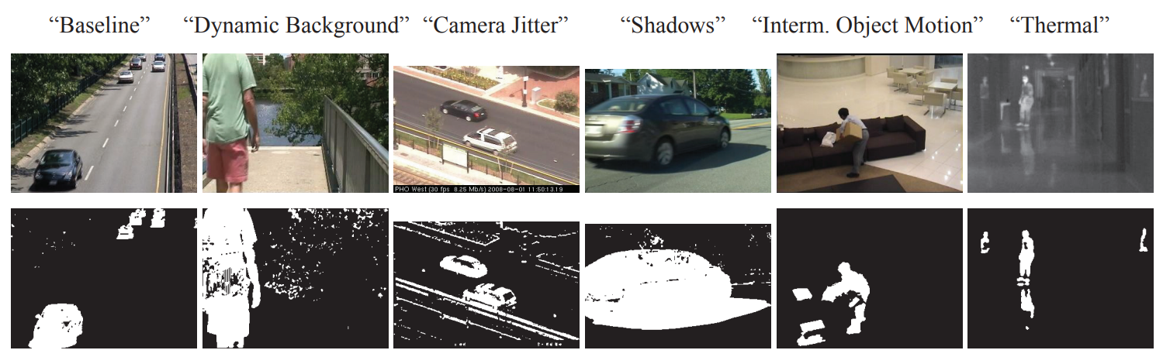
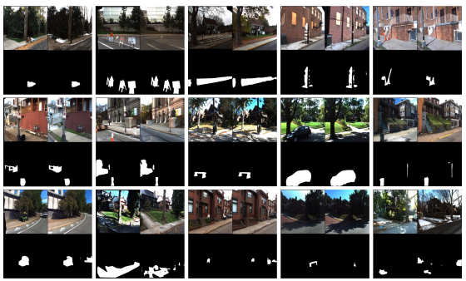
异物检测
COLLA 2022
CD2014
nearly 90,000 frames in 31 video sequences representing 6 categories selected to cover a wide range of challenges in 2 modalities
VL-CMU-CD
This task only contains “disappear” semantic changes. The training set consists of 933 image pairs, while the testing set consists of 429 pairs.

Slide 5
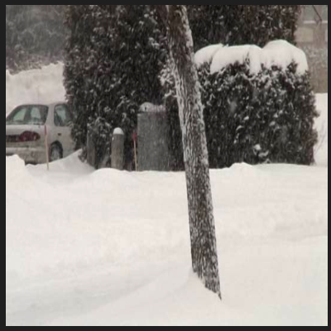
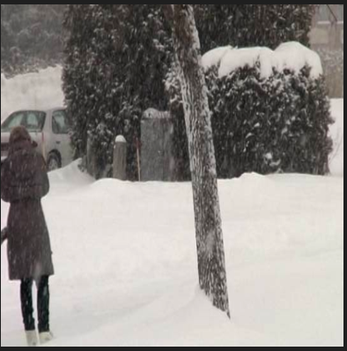
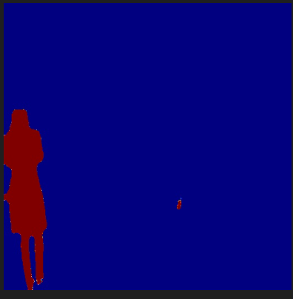
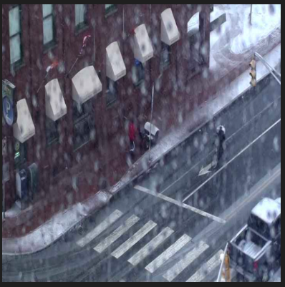
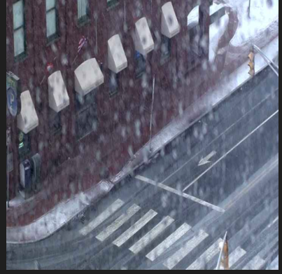
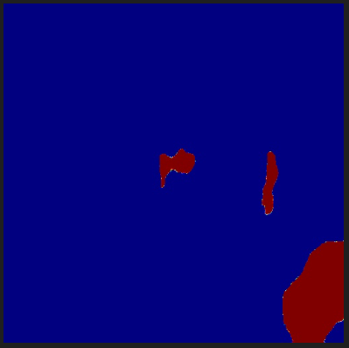
异物检测
Heat map
Notes:
10136 /data0/nyz/TransCD-main

Slide 6
异常行为检测
数据集 异常行为类别
UMN 人群乱跑；
UCSD 追逐、机动车/非机动车在人行道上；
Subway Entrance/Exit 地铁进出口乱走；
CUHK Avenue 奔跑，跳
UCF-Crime 暴力犯罪、恶性事件；
Street Scene 不遵守交规：行人在机动车道，非机动车在人行道上；
IITB-Corridor 校园内异常行为：游行；可怀疑的物品；脸部遮挡；斗殴；追逐；游荡等等
xd-violence 影视中暴力行为
ADOC 骑车，践踏草坪，交谈，人行道上各种交通工具
UBnormal 爬行，跳舞，跑步受伤，偷窃，打架，地上睡觉，烟雾，塌方，突发心脏病

